Slide 1
ABHIVRIDDHHI INFO TECH
An Overview

Slide 2
OVERVIEW OF THE ORGANIZATION
Company Name: Abhivriddhi Infotech.
Mission Statement: Empowering businesses through innovative and effective web solutions that drive growth and success.
Team: Our team comprises skilled and experienced professionals, including:
• Web Developers
• UI/UX Designers
• Mobile App Developers
• Project Managers
• Quality Assurance Specialists
• Business Analysts

Slide 3

Vision and Mission
Vision:
“To be a leading force in the digital landscape, pioneering innovative web solutions that transform businesses and enrich the online experience for users globally. We envision a future where our commitment to excellence and cutting-edge technology empowers organizations to thrive in the digital era. We aim to help youngsters with startup ideas & act as a startup incubator to fuel their ideas.”

Slide 4

Mission:
“At Abhivriddhi, our mission is to deliver tailored web development solutions that exceed client expectations. We are dedicated to leveraging our expertise in web technologies to create impactful, user-centric digital experiences. By fostering creativity, embracing challenges, and prioritizing client success, we aim to build lasting partnerships and contribute to the growth of businesses in an ever-evolving digital world.”

Slide 5


ORGANIZATION STRUCTURE
Abhilash Naidu G
CEO
(Test Engineer & SQL developer)
Sharath Kumar K
Content Creator & Front End
developer
Vignesh
Senior Spring Boot (java)
Developer
Manohara
Full Stack Developer
Arvind
Python Front End Developer
Shashidhar
Java back End Developer

Slide 6
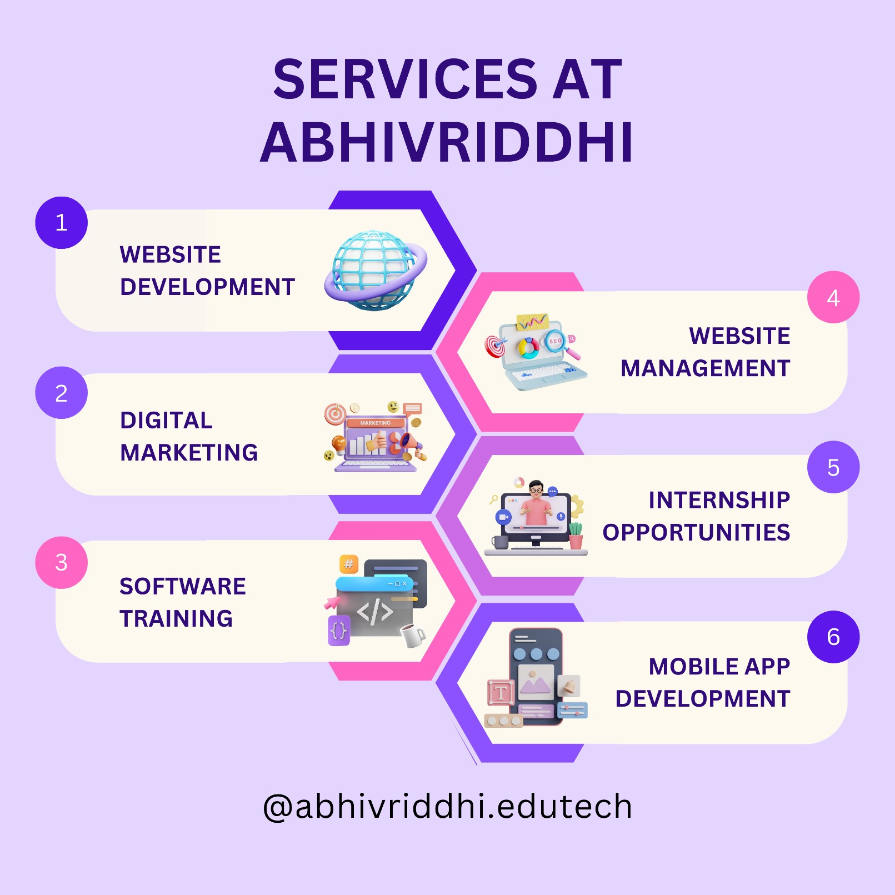
Services Offered:

Slide 7
Full Stack development
Topics:
Introduction to Front-end, Back-end, Database.
Front-end languages(HTML, CSS, JS).
Back-end languages(Java).
Database languages(MySql).

Slide 8
Introduction to front-end languages
HTML: It stands for hyper text markup language. It used to create structure or building blocks of the website.
CSS: It stands for cascading style sheets. It used to create design in the webpage and make website more attractive.
JS: It stands for Java Script. it is a Scripting language & it is used to add functionality
to the webpage.

Slide 9

Introduction to Back-end language:
Java: java is high-level programming language & it is statically typed, functionally typed, object oriented & it is both compiled and interpreter language.

Slide 10
Difference Between programming & scripting language
Programming lang
It is compiler based language.
It takes all lines of code at a time for
Execution if there is no error in any line
it executes or if any error in any line it
will terminate the whole code.
It multi threaded programming language.
It is statically typed language.
Ex:- Java, C, C++ etc.
Scripting language
It is interpreter based language.
It takes the code line by line for the execution
if there is no error all line are executed or if there is any error in any line it will stop the execution from that line.
It is single threaded programming language.
It is dynamically typed language.
Ex:- Python, JavaScript, Php, etc.
file
interpreter
file
interpreter
compiler
output
output

Slide 11
Data base language
SQL: it denotes “Structured Query language”.it stores data in a structural format and data is retrieve using queries.
Data: It is a raw fact which describes attributes of entity.
Database: It is place or medium in which we store the data in a particular and organized manner.
DBMS: It stands for Database Management System. It is used maintain and manage data.
Software
+ Security
+ Authorisation
data
Files
Databases
DBMS

Slide 12
Types of DBMS:
HDBMS(hierarchy DBMS)
RDBMS(Relational DBMS)
NDBMS(Network DBMS)
OODBMS(Object oriented DBMS)
RDBMS: It stands for relational database management system. It is also used to maintain and manage data
Software
+ Security
+ Authorisation
data
Tables
Databases
RDBMS

Slide 13
Thank you

